Slide 1
DEPARTMENT OF ZOOLOGY PATNA UNIVERSITY,PATNA
Dr. Anupma Kumari
Associate Professor
M.Sc. Semester II
Core Course (CC-5):Environmental Science
Topic: Water Pollution

Slide 2
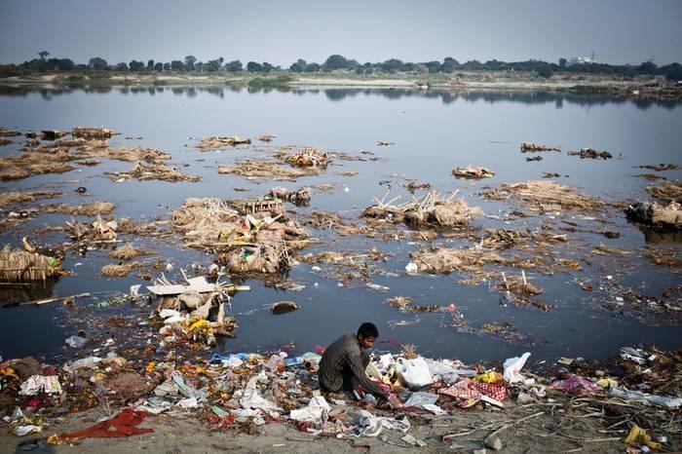
WATER POLLUTION
WATER POLLUTION

Slide 3
INTRODUCTION:
Water pollution occurs when toxic substances(often chemicals or microorganisms) contaminate a stream, river, lake, ocean, aquifer or other body of water, degrading water quality and rendering it toxic to humans or the environment.
These toxic substances (pollutants) include fertilizers and pesticides from agricultural runoff; sewage and food processing waste; lead, mercury and other heavy metals; chemical wastes from industrial discharges and chemical contamination from hazardous waste sites.
Categories of water pollution:
Surface water pollution- Surface water pollution is the pollution of aquatic systems that are above ground, such as streams, lakes and rivers.

Slide 4
Ground water pollution: Groundwater pollution occurs as a result of release of pollutants into the ground to natural underground water reservoir known as aquifers.
Marine pollution: Any detrimental alteration of the marine environment caused by the intentional or accidental release of dangerous or toxic substances, such as industrial, commercial and urban waste water is known as marine pollution.
Sources of water pollution
Point sources are distinct and confined, such as pipes from industrial or municipal sites that empty into streams or rivers
Nonpoint sources, such as runoff, are diffused and intermittent and are influenced by factors such as land use, climate, hydrology, geology etc.

Slide 5
Non-point source

Slide 6
Point Source

Slide 7
TYPES OF POLLUTANTS
ORGANIC POLLUTANTS: Organic pollutants are very wide in variety with a huge range of toxicity. It consists of protein, carbohydrates, fats and nucleic acids in a multiplicity of combinations. Among the list of organic pollutants that has been of great threat to aquatic organisms, human, plant and animal are dyes, pharmaceuticals, personal care product wastes as well as petroleum organic pollutants.
Sources: Domestic sewage(raw, untreated), urban runoff, industrial effluents
Effects: When an organic pollutants is discharged into a river, it is generally eliminated by the activities of micro-organism. Micro-organism required sufficient concentration of oxygen to decompose organic pollutants resulting in decrease of Dissolved Oxygen concentration and increase in BOD load.

Slide 8
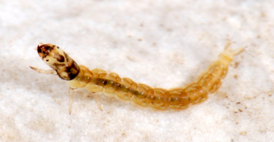
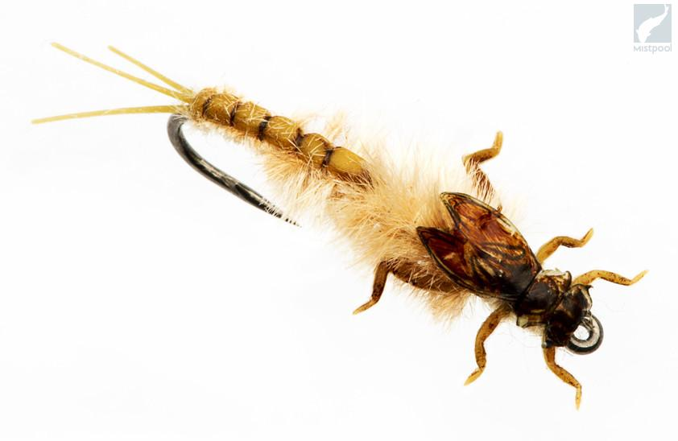
At high BOD levels, organisms such as macro invertebrates that are more tolerant of lower dissolved oxygen (DO), i.e., leeches and sludge worms may appear and become numerous.
Organisms which survive on higher DO levels, i.e., Caddisfly Larvae and Mayfly Nymphs will not survive.
CADDISFLY LARVAE MAYFLY NYMPHS

Slide 9
Pathogens:
A pathogen is usually defined as a micro-organism that causes, or can cause, disease.
Fecal contamination of water can introduce a variety of pathogens into waterways, including bacteria, viruses, protozoa and helminths.
The most frequently used indicators in the fecal pollution are the coliform bacterium(e.g. E.coli), Fecal streptococci and Clostridium.
Sources : Sewage effluent, Domestic effluent, Industrial effluent

Slide 10
BACTERIA
PATHOGEN CLASS | EXAMPLES | DISEASES
Bacteria | Shigella sp. | Bacillary dysentery
 | Salmonella typhi | Typhoid fever
 | Salmonella paratyphi | Paratyphoid fever
 | Vibrio cholera | Cholera
 | E. coli | Gastroenteric diseases
 | Mycobacterium | Tuberculosis
 | Campylobacter jejuni | Campylobacteriosis

Slide 11
VIRUSES
PATHOGEN CLASS | EXAMPLES | DISEASES
Viruses | Hepatitis A virus | Infectious hepatitis
 | Norovirus | Acute gastroenteritis
 | Rotavirus | Acute gastroenteritis
 | Poliovirus | Poliomyelitis
 | Coxsackievirus | Flu-like symptoms
 | Echovirus | Flu-like symptoms

Slide 12
PROTOZOANS
PATHOGEN CLASS | EXAMPLES | DISEASES
Protozoans | Entamoeba histolytica | Amoebiasis (Amoebic dysentery)
 | Giardia lamblia | Giardiasis (gastroenteritis)
 | Cryptosporidium sp. | Cryptosporidiosis (gastroenteritis)
 | Balantidium coli | Balantidiasis (gastroenteritis)

Slide 13
HELMINTHS
PATHOGEN CLASS | EXAMPLES | DISEASES
Helminths | Ascaris sp. | Ascariasis (roundworm infection)
 | Taenia sp. | Taeniasis (tapeworm infection)
 | Necator americanus | Ancylostomiasis (hookworm infection)
 | Trichuris trichuria | Trichuriasis (whipworm infection)

Slide 14
2.PESTICIDES AS WATER POLLUTANTS:
The term “pesticide” is a composite term that includes all chemicals that are used to kill or control pests.
In agriculture, this includes herbicides, insecticides, fungicides, nematicides and rodenticides.
e.g. Aldrin, Dieldrin, DDT, Endrin, Mirex, Toxaphene, Endosulfan,2-4D etc
Factors affecting pesticide toxicity in aquatic systems:
Toxicity:
Mammalian and non-mammalian toxicity usually expressed as LD₅₀. The lower the LD₅₀ , the greater the toxicity; values of 0-10 are extremely toxic (OMAF,1991).
Toxic response can be acute( death) or chronic( an effect that does not cause death over the test period but which causes observable effects in the test organisms such as cancers and tumors, reproductive failure, teratogenic effects etc.)

Slide 15
Persistence:
Measured as half-life( time required for the ambient concentration to decrease by 50%). It is determined by biotic and abiotic degradation process.
Degradate:
The degradation process may lead to formation of “degradate” which may have greater, equal or lesser toxicity than the parent compound. e.g. DDT degrades to DDD and DDE.
Environmental fate:
The environmental fate (behavior) of a pesticide is affected by the natural affinity of the chemical for one of four environmental compartments: solid matter (mineral matter and particulate carbon), liquid (solubility in surface and soil water), gaseous form (volatilization ) and biota.

Slide 18
SOURCES AND SETTINGS OF EXPOSURE
Indoor and outdoor application
Mosquito control
Professional/ domestic application
Health uses
Lice or scabies
Fleas or ticks on pets
Pesticide residues
Dust, soil, furniture, carpets, toys, food…
Playgrounds, playing fields, lawns, gardens
Wood preservatives in play structures (e.g. PCP: pentachlorophenol)
Long range transport of POPs( DDT)

Slide 19
ROUTES FOR ENTRY OF PESTICIDES INTO WATER
Non-point sources :
Spray Drift
Surface runoff
Leaching
Drain flow
Point sources :
Sewage effluent
Industrial effluent

Slide 20
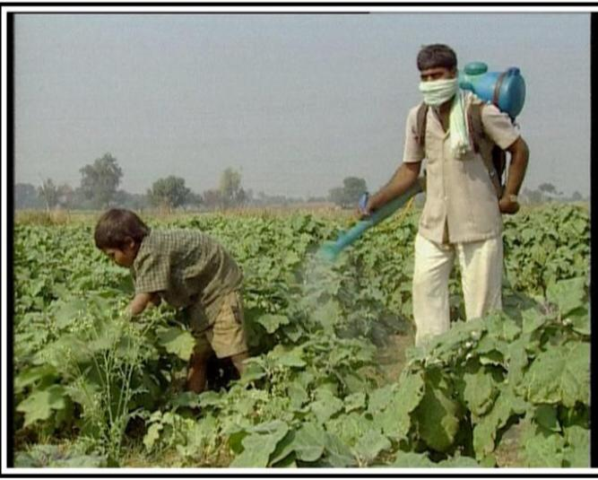
Pesticide drift

Slide 21
ECOLOGICAL EFFECTS
The principal pathway that causes ecological impacts is that of water contaminated by pesticide runoff. The two principal mechanisms are-
Bioconcentration : Movement of chemical from the surrounding medium into organism. The primary “sink” for some pesticides is fatty tissue. e.g. DDT accumulate in fatty tissue of fish whereas Glyphosate are metabolized and excreted.
Biomagnification : The process by which a compound (Such as a pollutant or pesticide) increases its concentration in the tissues of organisms as it travels up the food chain. e.g. DDT is a persistent contaminant that biomagnifies up the food chain, causing mortality, reproductive failure and other health effects in predatory wildlife and humans.

Slide 23
EFFECTS AT THE ORGANISM OR ECOLOGICAL LEVEL
The major types of effect are listed below and will vary depending on the organism and the type of pesticide.
Death of the organism
Cancers, tumors and lesions on fish and animals
Reproductive inhibition or failure
Suppression of immune system
Disruption of endocrine system
Cellular and DNA damage
Teratogenic effects
Intergenerational effects
Other physiological effects such as egg shell thinning.

Slide 24
3.FERTILIZERS AS POLLUTANTS:
Fertilizers: Any organic or inorganic material of natural or synthetic origin that is added to soil to supply one or more plant nutrients (nitrogen, phosphorus, small amount of potassium) essential to growth of plants.
Sources: Agricultural runoff, Leaching
1.Effects on human health due to nitrate:
Blue Baby Syndrome: The most common cause of blue baby syndrome is water contaminated with nitrates. When large amount of nitrates in water are ingested by an infant, the body converts the nitrates into nitrites. These nitrite then bind to the hemoglobin in the body, forming methemoglobin, which is unable to carry oxygen. If a large enough amount of methemoglobin is formed in the blood, blood tissue may be deprived of oxygen, causing the infant to develop a blue colouration of their mucous membranes and possibly digestive and respiratory problems. This condition is also known as methemoglobinemia.

Slide 25
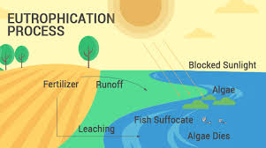
2.Effects Due to Nutrients:
Eutrophication ( from Greek eutrophos, “ well- nourished”): The process by which a body of water becomes enriched in dissolved nutrients (such as phosphorus and nitrogen) that stimulate the growth of aquatic plant life usually resulting in the depletion of dissolved oxygen.

Slide 27
Ammonia
It is a colourless pungent gaseous compound of hydrogen and nitrogen that is highly soluble in water. It is a biologically active compound found in most waters as a normal biological degradation product of nitrogenous organic matter (protein).
EFFECTS:
Increase pH value of water, causing stomach disorder
Blocks oxygen transfer in the gills of fish

Slide 28
4. HEAVY METALS AS POLLUTANTS:
a. Mercury Pollution:
SOURCES: It enters water naturally as well as through industrial effluents.
EFFECTS: Both inorganic and organic forms are highly poisonous.
Mercury poisoning is caused due to inactivation of several sulfhydral enzymes by replacement of hydrogen atoms in sulfhydral groups.
Mercury was responsible for Minamata epidemic that caused several deaths in Japan and Sweden. The tragedy had occurred due to consumption of heavily mercury contaminated fish (27 to 102 ppm, average 50 ppm).

Slide 29
MINAMATA DISEASE

Slide 30
b. Lead Pollution:
SOURCES: Effluents of lead and lead processing industries.
EFFECTS: Lead pollution caused damage to liver, kidney, reduction in heamoglobin formation, mental retardation and abnormalities in fertility and pregnancy.
Chronic lead poisoning may cause three general disease syndromes:
Gastro-intestinal disorders
Neuromuscular effects (leadlapsy)
CNS syndrome that may result to coma and death.

Slide 31
c. Fluoride Pollution:
SOURCES: Fluorides may enter a river as a result of industrial discharges. In groundwater, fluoride concentrations vary with the type of rock the water flows through.
EFFECTS: On an average about 20-25 million Indians are affected with fluorosis.
In our country this problem has become more severe in Rajasthan. Many people in Rajasthan have humped back due to high fluoride content in water sources in arid and semi arid zones.
Prolonged intake of fluoride containing water stiffens the bone joints, particularly of spinal cord.
Fluoride is not absorbed in the blood stream. It has an affinity with calcium and thus get accumulated in bones, resulting in the mottling of teeth, pain in the bones and joint and outward bending of legs from the knees (Knock Knee syndrome).

Slide 32
Fluorosis crippling in India

Slide 33
d. Arsenic Pollution:
SOURCES: Arsenic contamination of groundwater is a form of groundwater pollution which is often due to naturally occurring high concentrations of arsenic in deeper levels of groundwater.
EFFECTS: In South Asia, arsenic contamination in groundwater in the Ganga- Brahmaputra fluvial plains in India and Padma-Meghna fluvial plains in Bangladesh has been found to have a huge impact on human health and its consequences have been reported as the world’s biggest groundwater calamities.
It causes Arsenicosis, which occurs due to accumulation of large amounts of arsenic in the body. Arsenicosis leads to adverse health effects through inhibition of essential enzymes which ultimately leads to death from multi system organ failure.

Slide 34
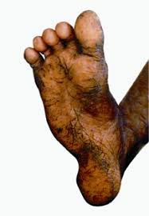
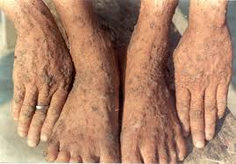
Arsenicosis

Slide 35
5.Thermal pollution
The broadest definition of thermal pollution is the degradation of water quality by any process that changes ambient water temperature. Thermal pollution is usually associated with increases of water temperatures in a stream, lake or ocean due to the discharge of heated water from industrial processes, such as the generation of electricity.
SOURCES: The major sources of thermal pollution are discharge of heated water into water bodies from:-
Nuclear power plant
Hydroelectric power
Coal fired power plants
Industrial effluents
Thermal shock

Slide 36
Iceland Geothermal Power Plant

Slide 37
Effects:
Elevated temperature decreases the level of dissolved oxygen of water.
Increases the metabolic rate of aquatic animals.
Warmer water can reduce the fertility of some organisms. Other species may suffer birth defects or lay deformed eggs because of chemical changes in the body caused by warmer water.
High temperature limits oxygen dispersion into deeper waters, contributing to anaerobic conditions.
Changes in the environment may also result in a migration of organisms to another, more suitable environment.
Loss of biodiversity
Increased toxins

Slide 38
6.OIL POLLUTANTS
An oil spill is the release of a liquid petroleum hydrocarbon into the environment especially marine areas due to human activity and is the form of pollution
SOURCES: Pipeline spills, tank vessel spills, operational discharges from cargo washings, coastal facilities spills, and gross atmospheric deposition of Volatile Organic Compounds(VOCs)s releases from tankers.
EFFECTS: -Oil spills frequently kill marine mammals such as whales, dolphins, seals and sea otters.
-Oil can clog blowholes of whales and dolphins ,making it impossible for them to breathe properly and disrupting their ability to communicate.
-Oil coats fur of otters and seals, leaving them vulnerable to hypothermia.
-Oil spills destroyed eggs of fishes such as salmon and herring eggs.
- Long-term damage to species and their habitats and nesting or breeding ground is one of the most far-reaching environmental effects caused by oil spills.
-Oil spills can disrupt migratory patterns of birds.

Slide 39
Exxon Valdez oil spill-The Exxon Valdez oil spill occurred in Prince William Sound, Alaska, March 24,1989, when Exxon Valdez, an oil tanker owned by Exxon Shipping Company, bound for Long Beach, California, struck Prince William Sound’s Bligh Reef, Alaska

Slide 40
7. RADIOACTIVE POLLUTANT
Radioactive pollution is the deposition of, or presence of radioactive substances on surfaces or within solids, liquids or gases, where their presence is undesirable.
Sources:
Radioactivity present in surface continental waters is mainly due to the presence of radioactive elements in the earth’s crust.
Other artificial radionuclides have appeared due to such human activities as nuclear power plants, nuclear weapons testing and manufacture and use of radioactive sources.
There are two sources of radioactive contamination in drinking water. The first is naturally occurring radionuclides that are contained in the soil that water moves through. The second source of radioactive contamination come from man-made sources.

Slide 41
Effects: Radionuclides found in drinking water are uranium, thorium and actinium and include the naturally occurring elements radium, uranium and the radioactive gas radon.
Radium concentrates in the bones and can cause cancers.
Uranium can cause cancers in the bones and can have a toxic effect on kidneys.
Bean et al.(1982) found increased rates of bladder cancer in males, breast cancer in females and lung cancer in both sexes in association with increasing ²²⁶ Ra concentration in community water supply.
In aquatic system, radiation can cause mutation, chromosome breakage, faulty segregation of chromosome among aquatic species. e.g. mutation in germ cells of Rainbow trout and Brine shrimp, aberrations in salivary gland chromosome of Midges.
Radiation can reduce fecundity, viability and fertility of freshwater snail and egg production was reduced in Amphipod.
The effects of radiation on freshwater species results in loss of some species which leads to reduction in diversity of species.

Slide 42
In Human Beings:
Low levels of localized exposure may only have a superficial effect and cause mild skin irritation.
Radioactivity is a health risk because the energy emitted by radioactive materials can damage or kill cells.
Long term exposure or exposure to high amounts of radiation can have serious health impacts. Radiation can cause irreparable damage to DNA molecules and can lead to a life threatening condition.
The rapidly growing/dividing cells such as skin, bone marrow are more sensitive towards radioactive emissions.
On the other hand, cells that do not undergo rapid cell division such as bone cells and nervous cells, aren’t damaged so easily.
Skin cancer, lung cancer and thyroid cancer are some of the common types of cancers caused by radiation effect.

Slide 43
Radiation can harm biological systems by damaging the DNA of cells

Slide 44
8.POLLUTION DUE TO SEDIMENS:
Sediment is the loose sand, clay, silt and other soil particles that settle at the bottom of a body of water
SOURCES: Soil erosion, decomposition of plants and animals.
EFFECTS:
Increased turbidity and decreased transparency
High levels of turbidity limit penetration of sunlight into the water column, thereby limiting growth of algae and rooted aquatic plants.
Disrupt the natural food chain by destroying the habitat
Finer suspended solids such as silt and coal dust may injure the gills of fishes and cause asphyxiation.
High levels of sedimentation in rivers leads to physical disruption of the hydraulic characteristics of the channel. This can have serious impacts on navigation through reduction in depth of channel and can lead to increased flooding.

Slide 48
Biological treatment
Biological treatments rely on bacteria, nematodes or other small organisms to break down organic wastes using normal cellular processes.
The goal of biological wastewater treatment is to create a system in which the results of decomposition are easily collected for proper disposal.
It is effective and more economical than many mechanical or chemical processes.
It is usually divided into aerobic and anaerobic processes.
Biological wastewater treatment is used as a secondary treatment process to remove material remaining after primary treatment processes.

Slide 49
Sewage treatment-Removing contaminants from municipal wastewater, containing mainly domestic effluent and some industrial effluent.

Slide 50
Primary treatment:
The objective of primary treatment is to removed-
Fats, oils and greases
Sand, gravels and rocks
Large settle-able solids
Floating materials
Methods used in primary treatment:
Physical treatment:
Screening-removes large suspended particles
Grit chamber- reduce the velocity of the sewage so that heavy particles may fall to the bottom . The solids are pumped to an auger pump which separates the water from grit ( mostly inorganic solids).
Floatation tank- removes oil and grease

Slide 51
Chemical treatment-
Sedimentation- suspended and colloidal impurities are separated in sedimentation tank by gravitation
Coagulation- destabilization of colloidal particles brought about by the addition of a chemical reagent called coagulant.
Flocculation- process by which fine particulates are caused to clump together into a floc . The floc may then float to the top of the liquid, settle to the bottom of the liquid, or be readily filtered from the liquid.
Filtration- remove colloidal and suspended matter remaining after sedimentation.

Slide 52
Principle- Organic matter is biologically degraded by different types of
microorganisms under controlled conditions

Slide 53
Main processes used during secondary treatment Trickling filters
A trickling filter consists of a beds of crushed stone
containing Biological slimes.

Slide 56
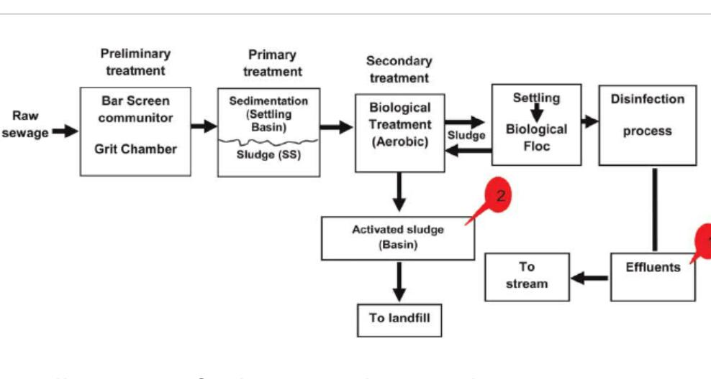
Flow diagram of sewage treatment plant

Slide 57
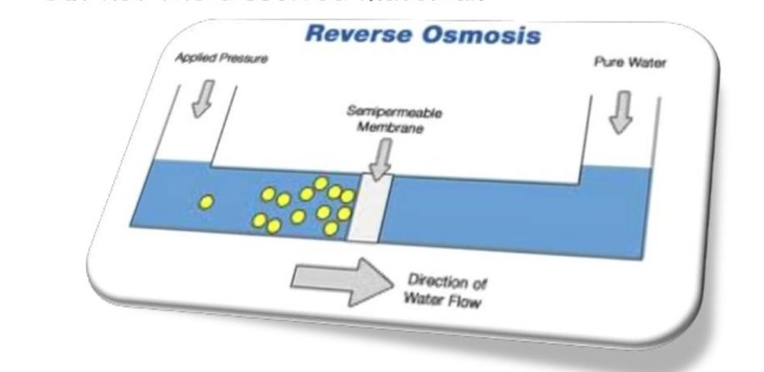
Removal of pollutant-Various pollutants (radioactive, chemical, biological) present in water body can be removed by appropriate methods such as ion exchange and reverse-osmosis etc.
Reverse osmosis : In this process, waste water is separated from fresh water by a semipermeable membrane which allows the water to move to it but not the dissolved material.

Slide 58
ABATEMENT OF WATER POLLUTION AND IMPROVEMENT OF WATER QUALITY
The initiatives taken by the Central and State Govts. are as follows:
Acts Enforced by Government
These includes the following:
The water (Prevention and Control of Pollution) Act, 1974
The water (Prevention and Control of Pollution) Cess Act, 1977
The water (Prevention and Control of Pollution) Amendment Act, 1988
The Environment (Protection) Act, 1986
The legislative measures are enforced by concerned Ministries at State levels and by Union Govt. at national level through recommendations and advice of State and Central Pollution Control Boards from time to time.

Slide 59
THANKS

